Slide 1
Selection AKA ifs

Slide 2
Flow of Control
Statement execution is linear unless specified otherwise
Some programming statements allow us to:
decide whether or not to execute a particular statement/block of statements
execute a statement/block of statements over and over, repetitively
These decisions are based on boolean expressions (or conditions) that evaluate to true or false
The order of statement execution is called the flow of control

Slide 3
Conditional Statements
A conditional statement lets us choose which statement will be executed next
Therefore they are sometimes called selection statements
Conditional statements give us the power to make basic decisions
The Java conditional statements are the
if statement
if-else statement
switch statement
Notes:
It is identical in C,C++,C# and many other languages.

Slide 4
The if Statement
The syntax of a basic if statement is:
The condition must be a
boolean expression. It must
evaluate to either true or false.
if is a Java
reserved word
if ( condition )
statement;
If the condition is true, the statement is executed.
If it is false, the statement is skipped.

Slide 5
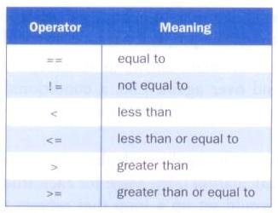
Equality and Relational Operators
Often, conditions are based equality operators or relational operators:

Slide 6
Conditions
Examples of if statements:
if (total == sum)
System.out.println("total equals sum");
if (count > 50)
System.out.println("count is more than 50");
if (letter != 'x')
System.out.println("letter is not x");

Slide 7
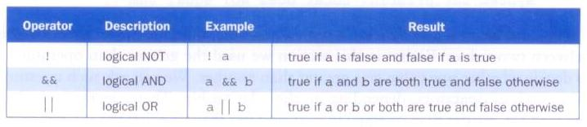
Logical Operators
Conditions can also use logical operators:
They all take boolean operands and produce boolean results
Logical NOT is a unary operator (it operates on one operand)
Logical AND and logical OR are binary operators (each operates on two operands)

Slide 8
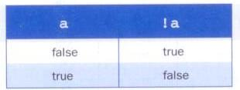
Logical NOT
The logical NOT operation is also called logical negation or logical complement
If some boolean condition a is true, then !a is false; if a is false, then !a is true
Logical expressions can be shown using a truth table:

Slide 9
Logical AND and Logical OR
The logical AND expression
a && b
is true if both a and b are true, and false otherwise
The logical OR expression
a || b
is true if a or b or both are true, and false otherwise

Slide 10
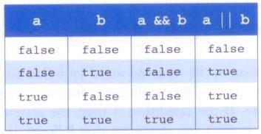
Logical AND and Logical OR
A truth table shows all possible true-false combinations of the terms
Since && and || each have two operands, there are four possible combinations

Slide 11
Logical Operators
Expressions that use logical operators can form complex conditions
if (total < MAX+5 && !found)
System.out.println("processing…");
All logical operators have lower precedence than the relational operators
Logical NOT has higher precedence than logical AND and logical OR

Slide 12
The if Statement
Consider the following if statement:
if (sum > MAX)
delta = sum – MAX;
System.out.println("The sum is " + sum);
First the condition is evaluated -- the value of sum is either greater than the value of MAX, or it is not
If the condition is true, the assignment statement is executed -- if it isn’t, it is skipped.
Either way, the call to println is executed next

Slide 13
Indentation
The statement controlled by the if statement is indented to indicate that relationship
The use of a consistent indentation style makes a program easier to read and understand
Although it makes no difference to the compiler, proper indentation is crucial
"Always code as if the person who ends up maintaining your code will be a violent psychopath who knows where you live."
-- Martin Golding

Slide 14
The if-else Statement
An else clause can be added to an if statement to make an if-else statement
If the condition is true, statement1 is executed; if the condition is false, statement2 is executed
One or the other will be executed, but not both
if ( condition )
statement1;
else
statement2;

Slide 15
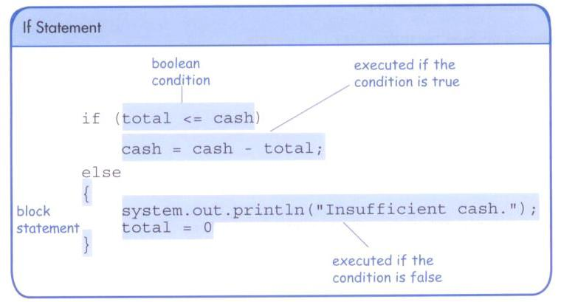
The if-else Statement

Slide 16
The if-else Statement
In an if-else statement, the if portion, or the else portion, or both, could be block statements
if (total > MAX)
{
System.out.println("Error!!");
errorCount++;
}
else
{
System.out.println("Total: " + total);
current = total*2;
}
...

Slide 17
The if..else if statement
In an if-else statement, the if portion, or the else portion, or both, could be block statements
if (total > MAX)
{
System.out.println("Error!!");
errorCount++;
}
else if (total == MAX)
{
System.out.println(“pROCESSING");
}
else
{
System.out.println("Total: " + total);
current = total*2;
}
...

Slide 18
Comparing Data
When comparing data using boolean expressions, it's important to understand the nuances of certain data types
Let's examine some key situations:
comparing floating point values for equality
comparing characters
comparing strings (alphabetical order)
comparing object vs. comparing object references...

Slide 19
Comparing Characters
In Unicode, the digit characters (0-9) are contiguous and in order
Likewise, the uppercase letters (A-Z) and lowercase letters (a-z) are contiguous and in order
Characters | Unicode Values
0 – 9 | 48 through 57
A – Z | 65 through 90
a – z | 97 through 122

